Slide 1
Understanding and Mitigating Risks from Supply Chain Disruptions in Food and Agriculture
Marty D. Matlock, PhD, PE, BCEE
Professor Biological and Agricultural Engineering
University of Arkansas
Fayetteville, AR 72701
479-935-6013 (cell)
mmatlock@uark.edu

Slide 2
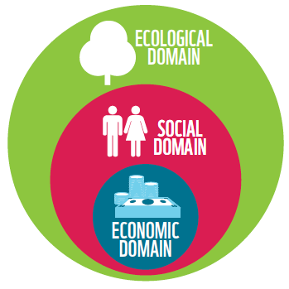
Everything is Connected

Slide 3
Everything is changing

Slide 4
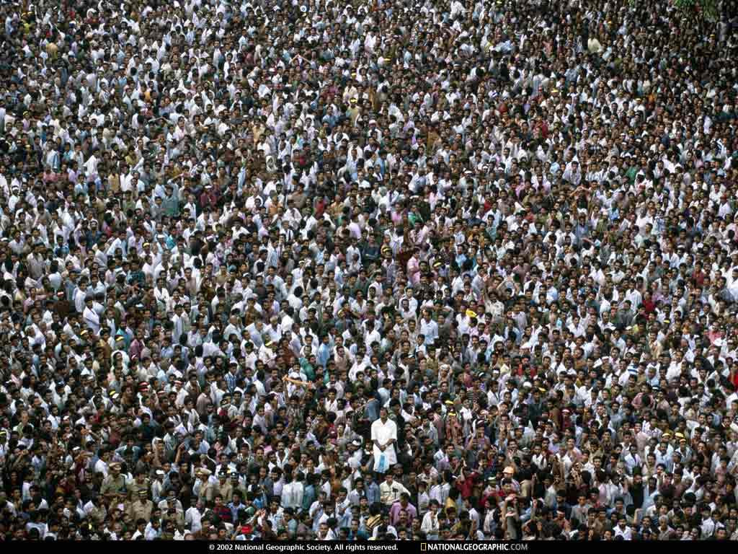
We are all in this together

Slide 5
The Global Food Supply Chain
The Global Food Supply Chain the most extensive human endeavor in history.
We produce, process, transport, distribute, and consume nearly 22 trillion kilocalories of food to people every day.
While nearly 900 million of our brothers and sisters are still chronically food insecure, more than 6.4 billion people know where their breakfast will come from.
This amazing system is economically efficient but is very fragile and wasteful at the consumer level.

Slide 6
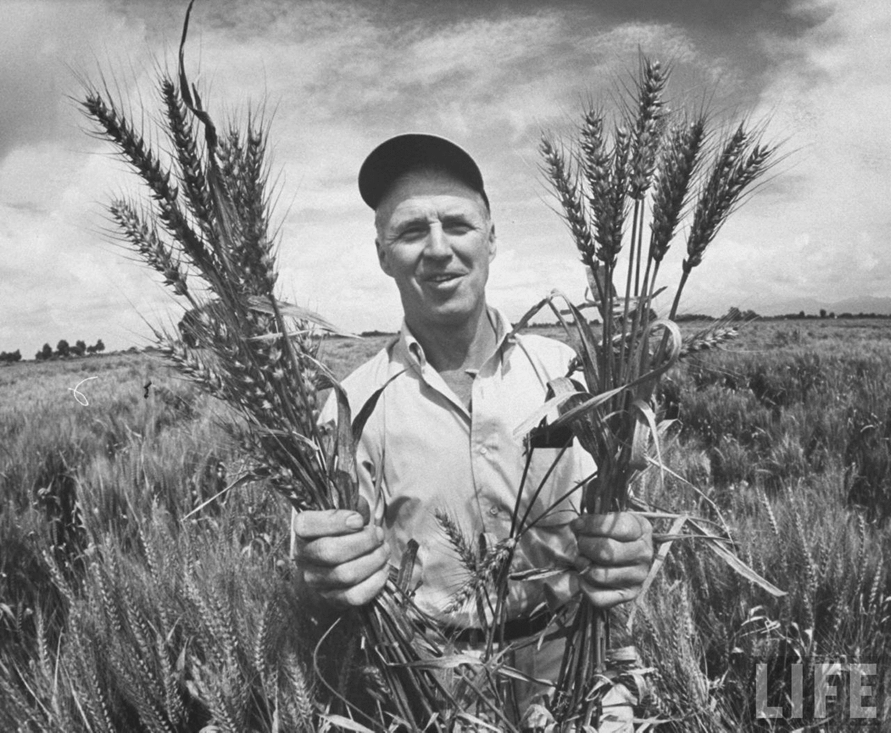
The Green Revolution has saved more lives and conserved more species than any other initiative in human history.

Slide 7
The Global Food Supply Chain

Slide 8
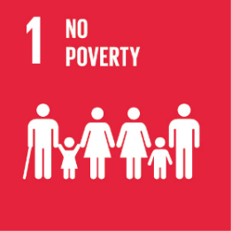
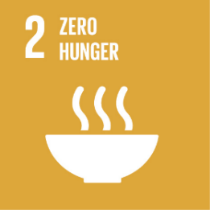
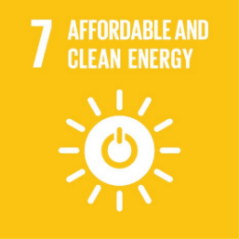
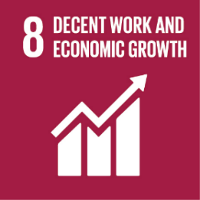
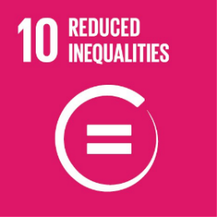
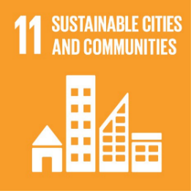
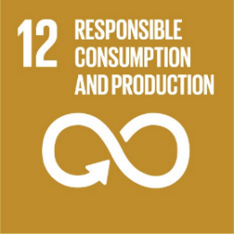
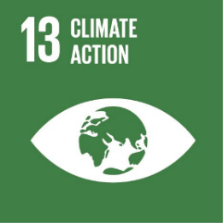
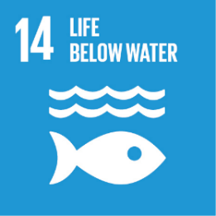
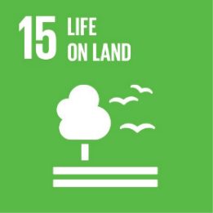
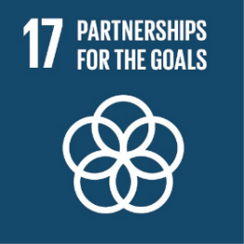

Slide 9
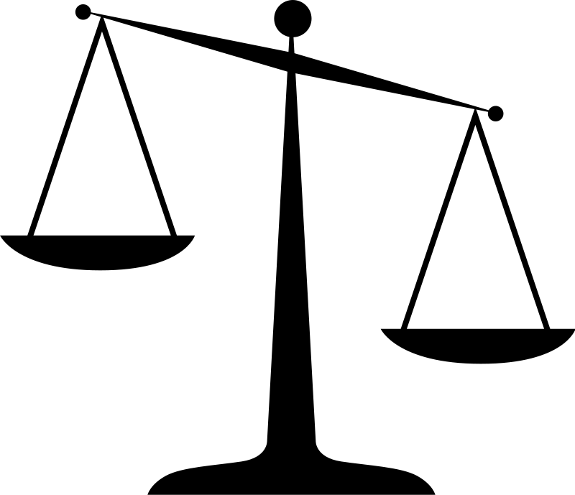
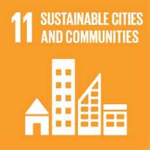
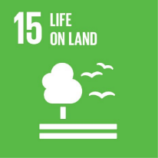

Slide 10
Sourcing for a single product is global
Macfadyen, S., Tylianakis, J. M., Letourneau, D. K., Benton, T. G., Tittonell, P., Perring, M. P., ... & Smith, H. G. (2015). The role of food retailers in improving resilience in global food supply. Global Food Security, 7, 1-8.

Slide 11
Food System Supply Chain Risks
Supply Side
Sourcing stability
Sourcing quality
Adulteration
Demand Side
Intermediate processor disruption
Transportation
Distribution network disruption
Consumer demand disruption

Slide 12
Food System Supply Chain Risks
Global Climate Change Political instability Pandemic | Regional Drought Flood Transportation Labor | Local Fire Freeze Storm Disease

Slide 13
Knowing Where and When Risks Occur
Supply Side Risks
Mapping all components
Critical Component Analysis
Life Cycle Assessment
Mitigation of Risks
Redundant sources
Alternative components
Diverse pathways

Slide 14
Food System is a Complex Meta-System

Slide 15
Environmental Risks to Food Production
Davis, K. F., Downs, S., & Gephart, J. A. (2021). Towards food supply chain resilience to environmental shocks. Nature Food, 2(1), 54-65.

Slide 16
Understanding how to reduce impacts from complex systems within systems (metasystems) requires a systems approach such as Life Cycle Assessment

Slide 17
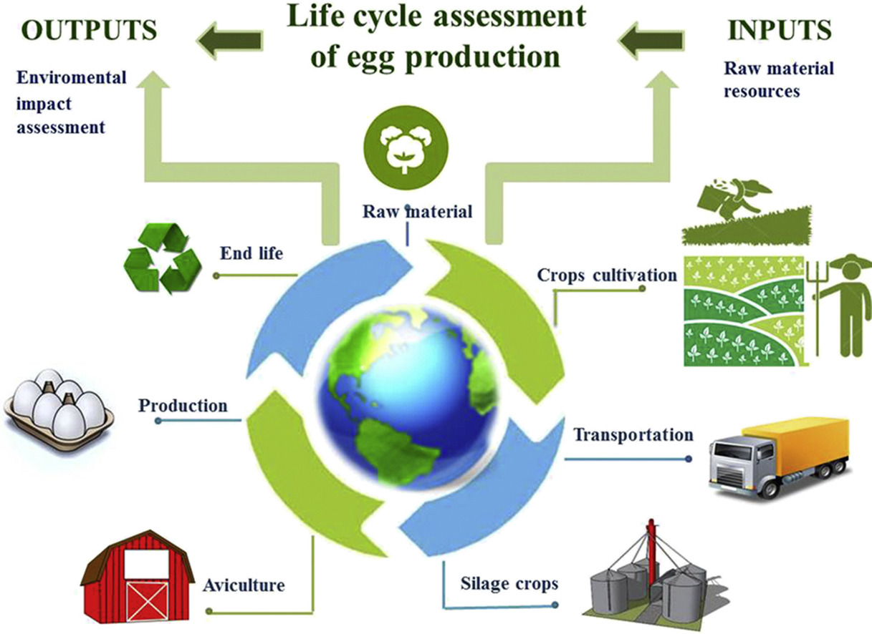
Life Cycle Assessment

Slide 18
Unit Processes are the accounting elements
Outputs to nature
Inputs
from
other
processes
Outputs
to
other
processes
Inputs from nature

Slide 19
Unit Processes are the accounting elements linked together in Reference Flow

Slide 20
Wilfart, A., Gac, A., Salaün, Y., Aubin, J., & Espagnol, S. (2021). Allocation in the LCA of meat products: is agreement possible?. Cleaner Environmental Systems, 2, 100028.

Slide 21
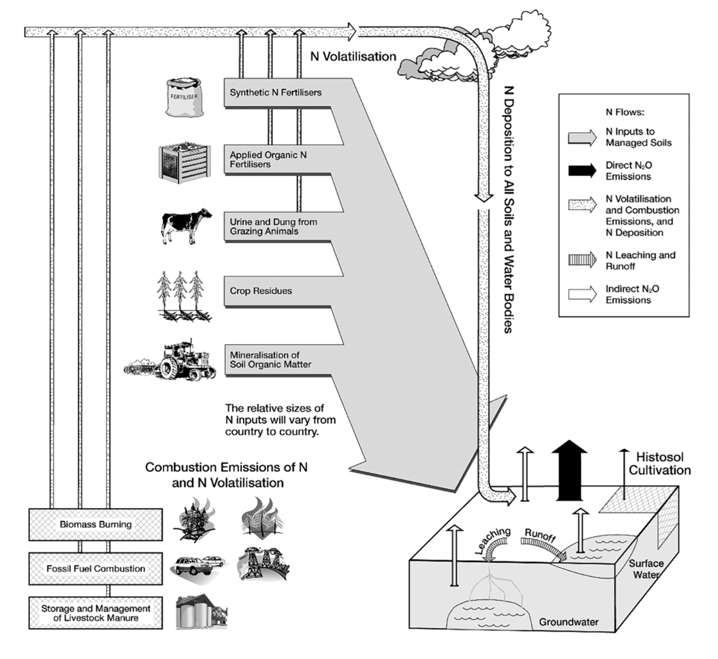
Agricultural LCAs are particularly complex…
Ag LCAs touch almost every part of the Biosphere and Technosphere.
Nitrogen use impacts are particularly complex.
https://www.ipcc-nggip.iges.or.jp/public/2006gl/pdf/4_Volume4/V4_11_Ch11_N2O&CO2.pdf

Slide 22
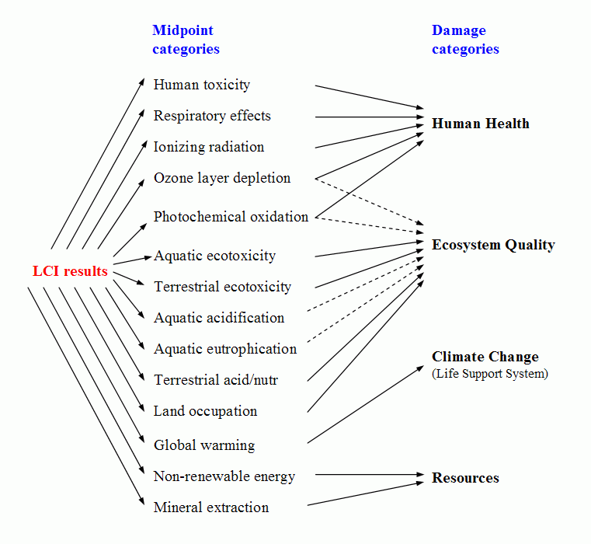
LCIA: Quantifying Systems Impacts
High Confidence/ Lower Understanding
Low Confidence/
Greater Understanding
( e.g. kg C₂H₃Cl- eq)
(e.g. DALY’s)
( Endpoint Categories )
Single Score
Normalization and Weighting

Slide 23
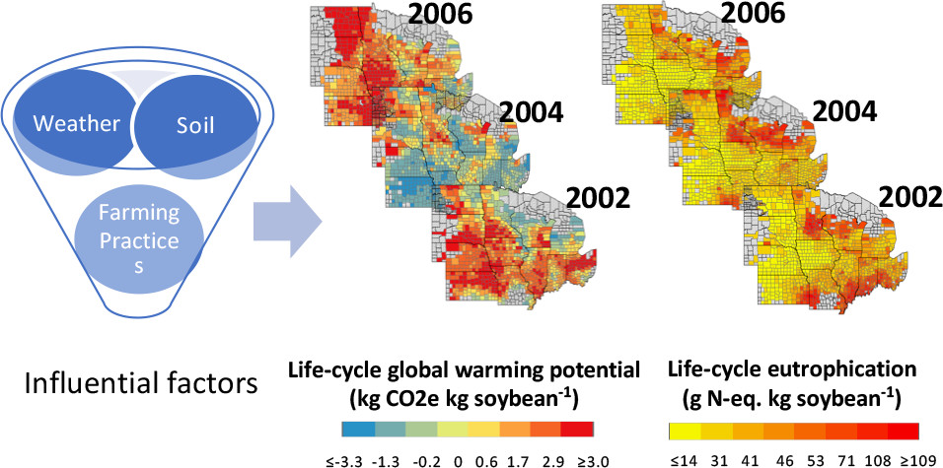
Romeiko et al., 2020, Environ. Sci. Technol. 2020, 54, 8, 4758–4768 DOI: (10.1021/acs.est.9b06874)

Slide 24
Food Waste is a Major Food System Weakness

