Slide 1

Climate-Related Supply Chain Disruptions; Social Impacts, Tools and the Benefits of Reduced Risks
USDA’s 2022 Agricultural Outlook Forum
“New Paths to Sustainability and Productivity Growth”
Kevin Lyons, Ph.D.,
Associate Professor, Supply Chain Archaeology
Supply Chain Management Department
Rutgers Business School
Director, Public Private Community Partnerships
Road, Piscataway, NJ 08854
klyons@business.rutgers.edu

Slide 2

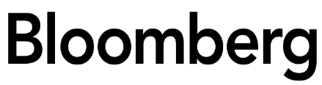
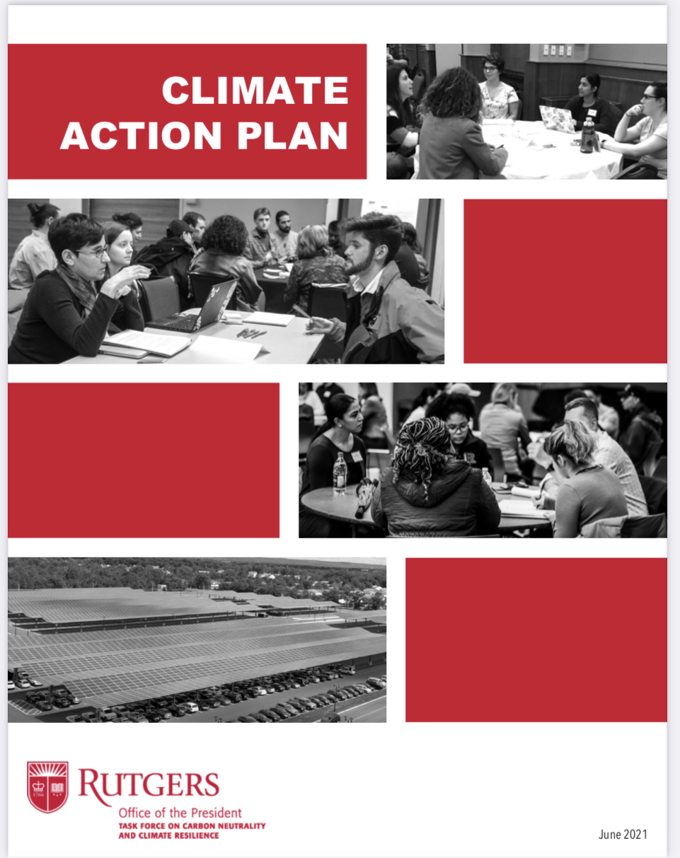
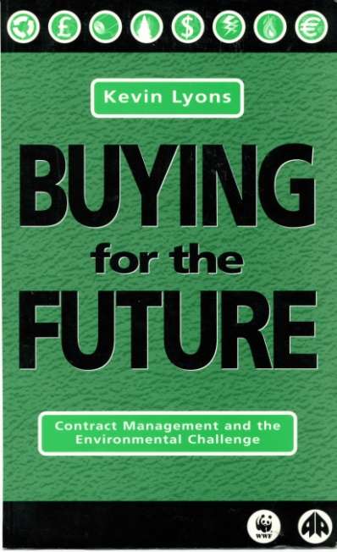
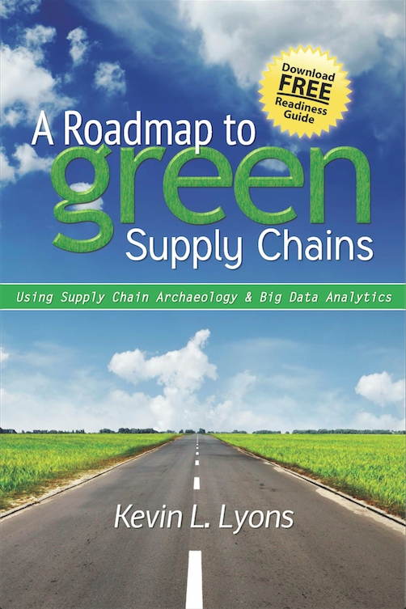


Overview
Background
Case for Climate Action
Supply Chain Climate Research
Climate Resilience Tools

Slide 3
Kevin Lyons, Ph.D.
Rutgers – 33 Years (Faculty-CPO)
St. Peter’s Medical Center – 2 Years
U.S. Air Force – 6 years
Ph.D. Supply Chain Management and Environmental Management
Areas of Research/Work:
Procurement – Supply Chain Management
Supplier Diversity
Economic Development – Social Impact – Social Determinants of Health (Newark 2020)
Complex Decision Analysis
Manufacturing
Supply Chain Workforce Development
Environmental Sustainability
Mandela Washington Fellowship
Sub-Saharan Africa Agriculture and Entrepreneurship
Current Board Membership:
Rutgers Climate Action Office; Co-Director
NJ Council on the Green Economy
NJ Recycling Market Development Council
Newark Equitable Growth Advisory Commission
Rutgers Institute for Corporate Social Innovation
Rutgers Global Health Institute (Core Faculty Member)
Rutgers Center for African Studies
Rutgers Office for the Promotion of Women in Science, Engineering & Mathematics (WiSEM)
Rutgers Earth, Ocean and Atmospheric Science Institute
Rutgers EOHSI Division of Global Environmental Health
Member:
Institute for Supply Management (ISM)
Chartered Institute of Procurement and Supply (CIPS)
Current Significant Research Project:
Newark 2020-Buy Local (Researcher, Board Member)
Newark Anchor Collaborative (Member, Researcher)
NJEDA (NJMEP Grant) NJ Manufacturing Research (NJMEP Board of Trustees)
Center of Accelerated Real Time Analytics an NSF Industry/University Cooperative
Research Center (Researcher)
Rutgers Energy Institute (Associate Director)
Rutgers EcoComplex (Researcher)
Rutgers Edison Papers (Board Member and Researcher)
DOE Supply Chain Risk Roundtable (Researcher)

Slide 4
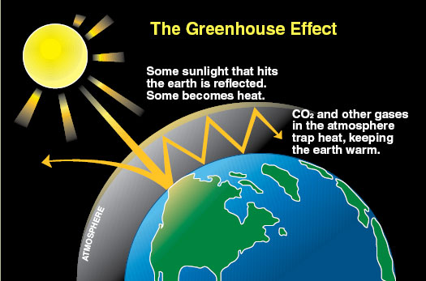
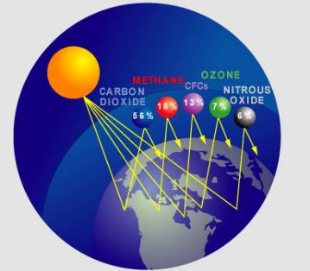
For many companies, at least 75% of carbon emissions are from the supply chain.

Slide 5
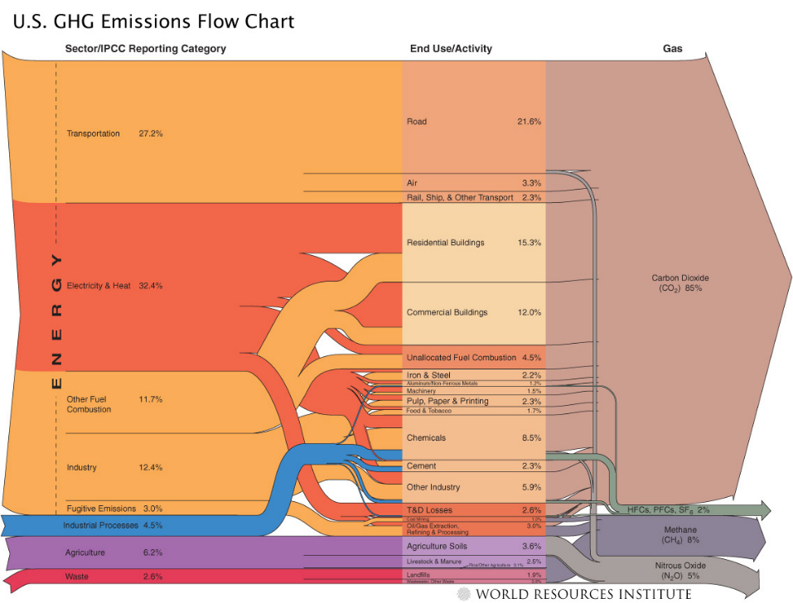

Slide 6
Why consider the environment?
Supply Chain Management with a ‘DfE’ mindset can:
Reduce energy and water consumption (which can reduce costs)
Improve resource use efficiency
Reduce waste (which can reduce waste disposal costs); archaeology
Reduce environmental health impacts of goods and services.
Potential post-consumer feedstock
Potential Benefits:
Improves Agility
Increases Adaptability
Promotes Alignment
Bring Value
DfE-Design-for-the-Environment

Slide 7
Rutgers University
Product Carbon/Climate Impact Research
Measuring carbon emissions at every step of the supply chain
could lead to valuable energy and cost saving opportunities
(for the General Public, Rutgers, and our Manufacturers).
“Carbon Footprinting” is a way to measure the impact human
activities have on the environment, in terms of the amount of
greenhouse gases produced, measured in units of carbon
dioxide.
Rutgers Carbon Reduction Label Concept:
The Rutgers Carbon Reduction Label would show the total
Greenhouse gas emissions from every stage of the product's
lifecycle, including production, transportation, preparation, use
and disposal.

Slide 8
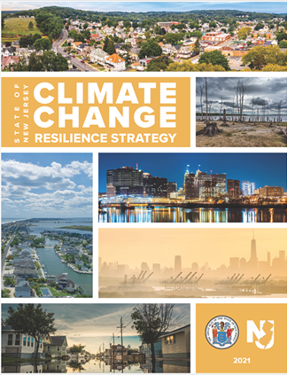
A climate resilience process
  Identify future threats and opportunities
  Possible threats and opportunities from future climate change can be categorised by business function or by sector:
      Typical business functions might include: markets, processes, logistics, people, premises and finance.
      Sectoral examples could include agriculture, finance, health, retail or oil & gas.
 | Threats (negative impacts) | Opportunities (positive impacts)
Finance | Increased insurance premiums | New market opportunities
Supply Chain | Increased disruptions and delays | Local Sourcing Market Development
Premises | Repeat flooding, Droughts, Pests | Opportunity to relocate

Slide 9
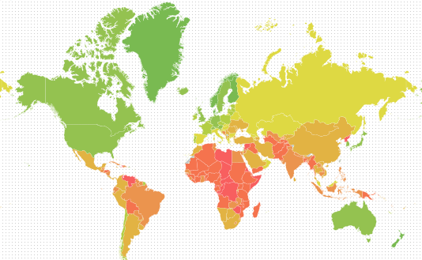
A climate resilience process: Tool #1
Datasets and tools
  ND GAIN Country Readiness Scores
Since 1998, the University of Notre Dame has published an annual Index based on countries’ vulnerability to climate and other risks, and their readiness to build resilience.

Slide 10
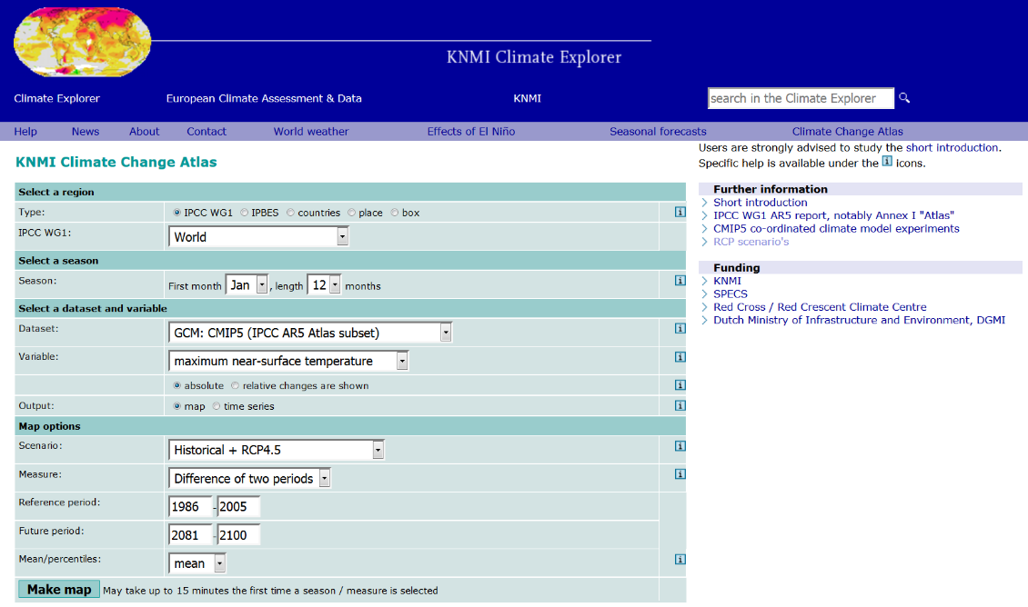
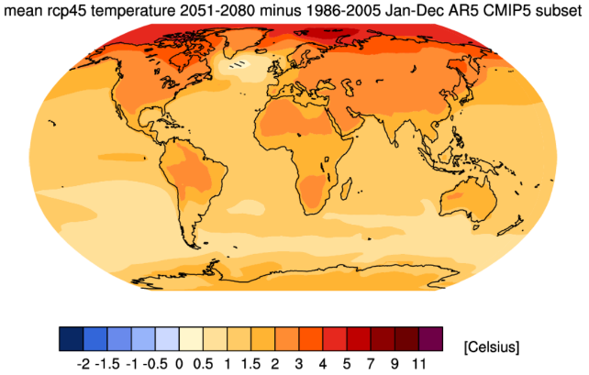
A climate resilience Tool #2
  Datasets and tools
    KNMI Climate Change Atlas
    The latest observed, reanalysis and climate projection data accessible through an easy-to-use user interface.
Includes the following
core IPCC projection
variables, as well as
multiple extreme
parameters:
Near-surface min/max temperature
Precipitation
Evaporation, transpiration, sublimation
P-E, net water flux
Moisture content of soil layer
Humidity (specific and relative)
Downward solar radiation
Air pressure at sea level
10

Slide 11
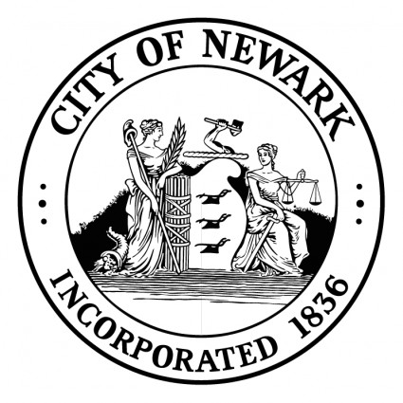
Newark Anchor Collaborative
Newark 2020 Program
Local Sourcing for:
Economic Development
Social Impact
Climate Impact Reduction
  Tool #3-5
New Jersey’s most populous city
America’s 3rd oldest city (est. 1666)
One of many U.S. “legacy cities”
City of Newark’s effort to strengthen and grow its
local and regional manufacturing and business base.
*Anchor:
30% supply
-----------
70% demand

Slide 12
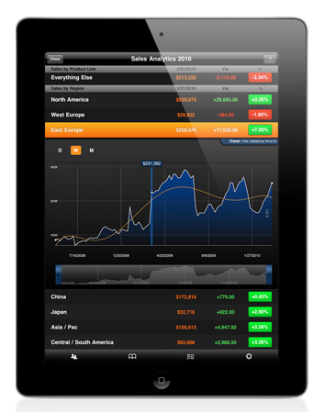
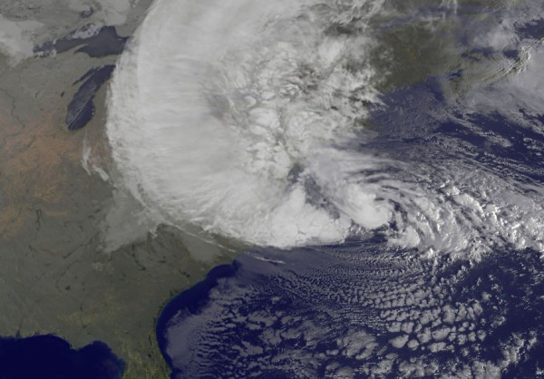
Climate Impact…Analyzing Supply Chain Risks and Responses Utilizing Big Data Analytics
Impact of “Super Storms” on the Supply Chain
Rutgers Tool #3
Rutgers Business - Big Data Analytics Climate Impact and Supply Chain/Procurement Impacts

Slide 13

Rutgers Tool #4

Slide 14
Rutgers Tool #5

Slide 15
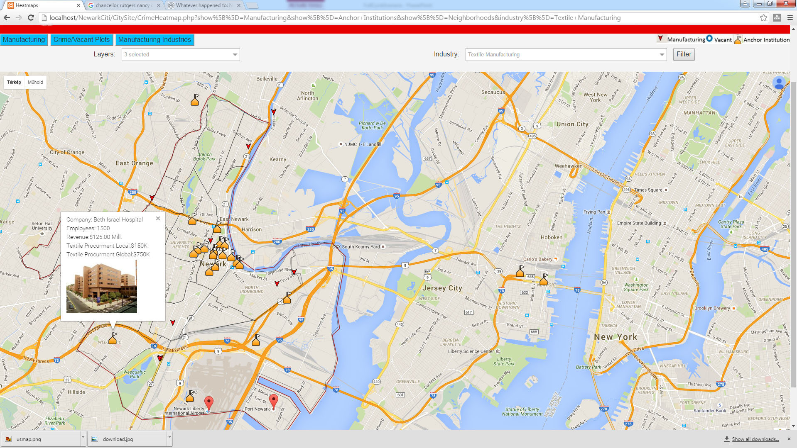
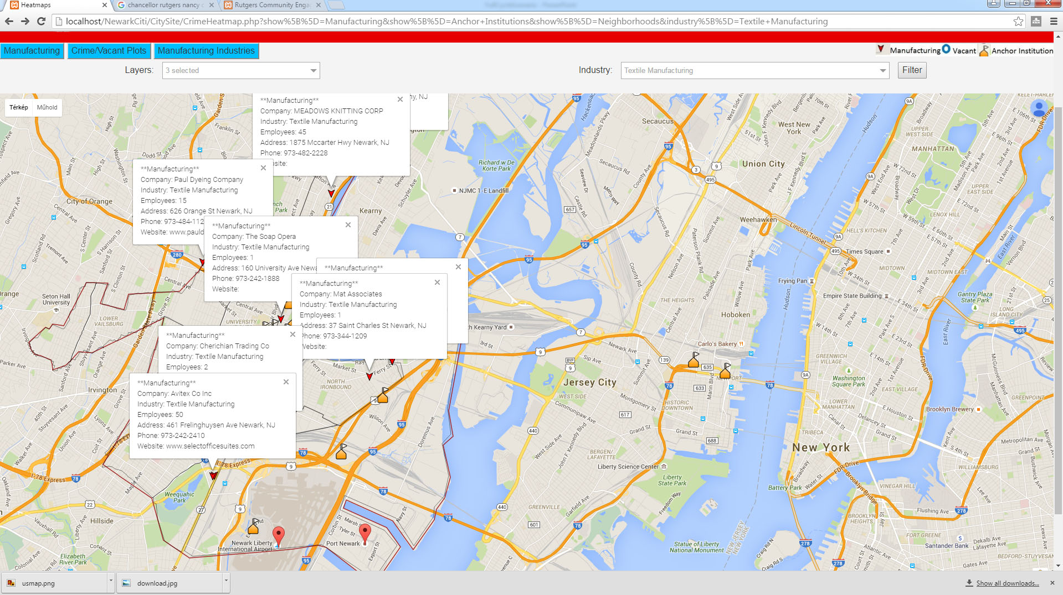
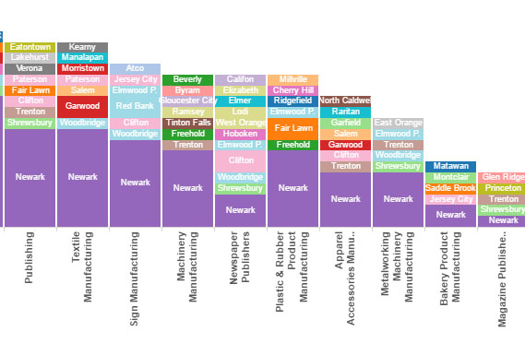
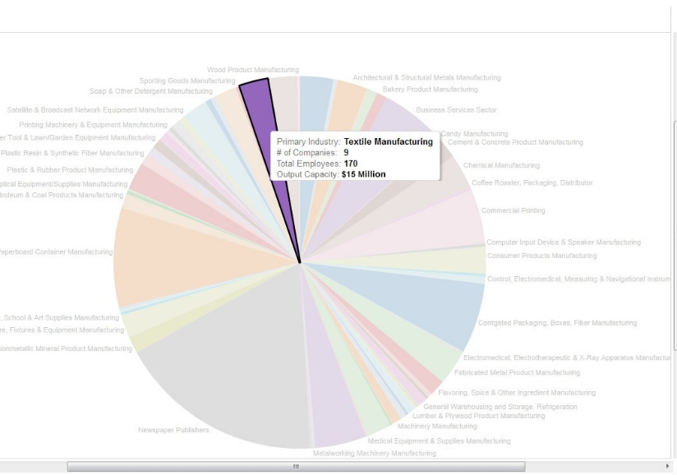

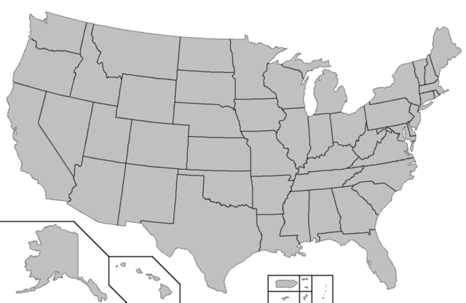
Newark Anchor Buy Local – Climate Impact Program
Rutgers Tool #6
Our system can show a simulation of a Beth Israel's textile procurement
There are 9 companies in textile manufacturing in Newark employing 170 people with potential capacity of $15 Million
At the same time the Anchor procures $5 Million worth of textile products from outside of the Newark area
Using the industry filter all companies in textile industry can be visualized on the map
Our analytics shows that Newark’s Textile industry is very significant compared to the neighboring cities
Textile Procurement Local: $150K
TAnchorTotal Procurement: $5Mill.
If Beth Israel procured $150K worth of textile products from 2 local manufacturers
Rutgers Business - Big Data Analytics Climate Impact and Supply Chain/Procurement Impacts

Slide 16
Newark Anchor Buy Local – Climate Impact Program
Rutgers Tool #6
Newark would have additional capacity to fulfill Beth Israel's and several other anchor’s textile needs.
Buy Local Climate Impact Calculator:
Greenhouse Gas Emissions (CO2 Emissions Reduction)
86,354,000kg CO2e
Rutgers Business - Big Data Analytics Climate Impact and Supply Chain/Procurement Impacts

Slide 17
In summary
Climate risks - exposure, vulnerability, and hazard;
Assessing and managing climate risk is an increasingly routine component of risk management schemes and investment due diligence processes;
There is no universal method to assess climate risk; tools are available!
Obtaining the right data and information is an important early step in any climate risk process;
Adaptation involves:
  1. Recognizing that the risk landscape is changing
  2. Make decisions that allow likely impacts to be reduced or managed, and deploy adaptation actions that are flexible
  3. Adaptation actions need to be physical, financial, informational, governance and collaborative

Slide 18
Dr. Kevin Lyons Ph.D.
Associate Professor PP,
Supply Chain Management
Rutgers University
klyons@rutgers.edu

