Slide 1
Considerations for U.S. Sugar Policy Kent Lanclos USDA FPAC Business Center
USDA Agricultural Outlook Forum
February 25, 2022

Slide 2
Sugar Program Administration
Statutory mandate: “… the Secretary shall adjust the overall allotment quantity to maintain—
‘‘(A) raw and refined sugar prices above forfeiture levels to avoid the forfeiture of sugar to the Commodity Credit Corporation; and
‘‘(B) adequate supplies of raw and refined sugar in the domestic market.’’;
Historically, SUR between 13.5% and 15.5% kept prices in the “Goldilocks” range—
High enough to avoid forfeitures
Low enough to avoid high tier imports
P*
Q*

Slide 3
Historical SUR & Price

Slide 4
FY21/FY22 SUR & Price

Slide 5
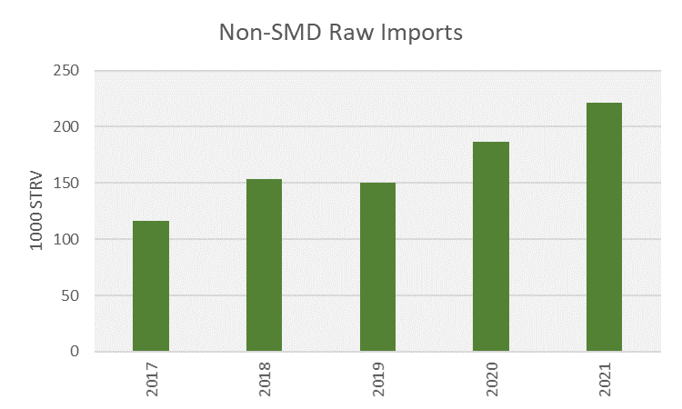
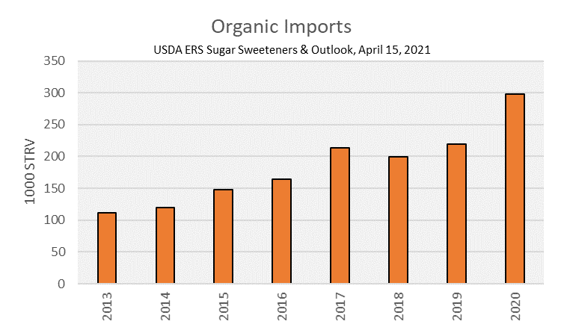
Why the Divergence

Slide 6
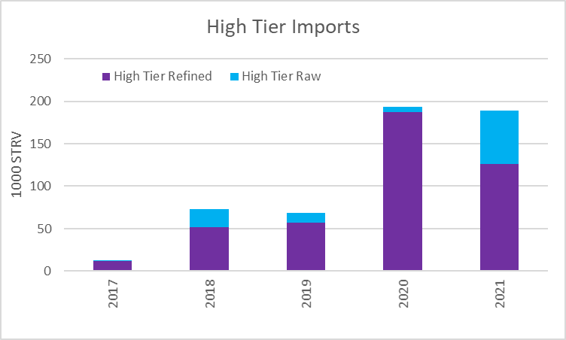
High Tier Imports
Actuals
Futures

Slide 7
Adequate Supply Metric
Is current situation a temporary phenomenon or does it represent a permanent change in market dynamics
Is some alternative measure appropriate
Should price be an explicit consideration
Notes:
Structure of import demand is changing … organic, vertically integrated refiners, increased high tier
But how much is pandemic related, e.g., issues with logistics, transportation costs, etc.
Should we remove organic imports, high tier, etc. from the SUR calculation to give us more flexibility to address conventional raw sugar needs?
The measure shown in this chart is focused on raw imports and fits the pattern of recent years fairly well … but is that simply a coincidence and will not generalize?
Larger ratio indicates greater availability.
Between 2012 and 2019, this ratio ranged from 1.09 to 1.13, i.e., raw sugar supplies were equal to 109 percent to 113 percent of food use
Ratio much lower for 2020 and 2021 at 1.03 and 1.05, respectively
With food use of 12.2 million STRV, a 1.05 ratio represents a reduction in raw supplies of about 600,000 STRV as compared to a ratio of 1.10.
By this metric, raw supplies in 2020 and 2021 were much tighter than in any year since 2011, a year in which raw sugar prices reached comparable (if not higher) levels to those of today.
Should there be an explicit price objective rather than the side-eye approach we currently use?

Slide 8
Tools Available to Adjust Supplies
Tariff rate quotas
TRQ allocations do not reflect current production/trade patterns
Refined TRQ imports require further processing
Specialty (organic) imports supposed to be refined but require further processing
U.S./Mexico suspension agreement
Export limit periodically reset based on 13.5 percent SUR
Fixed split between raw and refined
OAQ and Processor Allocations
OAQ does not reflect current production levels for beet and cane sugar
Beet and cane sector allotments, as well as some individual beet and cane processor allocations do not reflect current levels of expected production

Slide 9
Overarching Issue
Ongoing tensions and challenges in sugar program management
Provides fodder for program critics
Sugar market is dynamic … are current program design, parameters and tools adequate for an evolving market?

