Slide 1
Challenges and Prospects for Growth in the Global Market
Jim Sutter – Chief Executive Officer
JimSutter
@1JSutter

Slide 2

Carbon Footprint of U.S. soy
Carbon Footprint of soybean for European market (kg CO₂ eq/kg soybean)
*footprint results are based on country average statistics, supplier specific information improves quality of results
Source: Blonk Consultants, Agri-footprint
Notes:
<click mouse>
We asked Blonk Consultants, a leading international expert in food system sustainability, to use the Agri-footprint database to evaluate the carbon footprint of soybeans from different sourcing countries, which are listed at the bottom of the axis.
<click mouse>
Looking at the cultivation and the transport of soybeans going to the European market you can see that cultivation is the biggest contributor to the global warming impact of soybeans. Energy use, fertilizer production and application, and crop residues emissions are the most important parameters for the cultivation emissions. The countries with relatively low impact have high yields, low fertilizer use, efficient machinery, high levels of mechanization, and precision farming techniques to minimize emissions.
When we add in Land Use Change you will see a dramatic difference in the carbon footprint.
<click mouse>
Looking at the impact of Land Use Change over the past 20 years, which is the industry standard, you can see it dramatically changes the results. The numbers at the top of each bar are the land use change impact only. Land use change in Argentina and Brazil, primarily due to deforestation, has a significant impact on the crop’s carbon footprint. You can see that the U.S. has the lowest amount of land use change and has the lowest carbon footprint overall.
Notes on Land Use Change
land use change is calculated according to the PAS 2050-1 standard. The PAS 2050-1 standard is the most applied method for calculating the land use change impact on the carbon footprint. Based on country-level statistics on the expansion or regression of cropland and forest area, deforestation is assigned to crops with high relative expansion.

Slide 3
U.S. Soy Sustainability Assurance Protocol Shipments
2014-2022
(01/13/2022)
Notes:
This slide really demonstrates how much the interest and important of sustainability has grown in just a few short years. In 2014 when the SSAP was developed, 6,845 Metric Tons of soy were exported with the verification of sustainability. In the current marketing year, which started in September, we are well over 23 million metric ton.

Slide 4
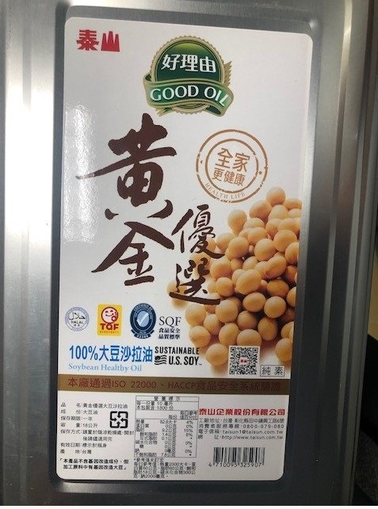
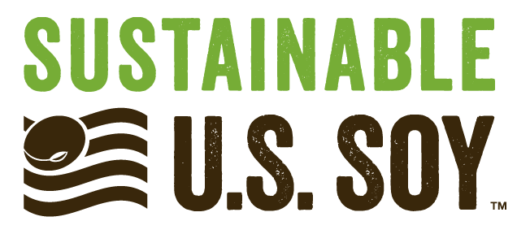
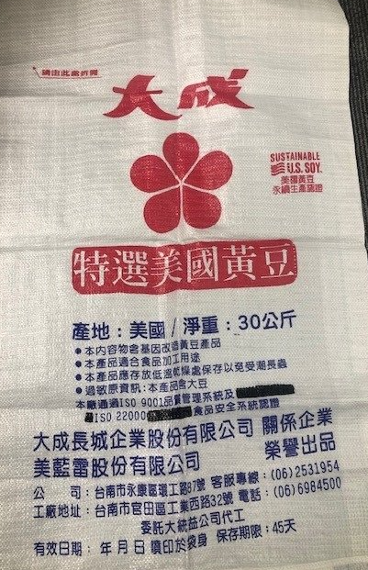
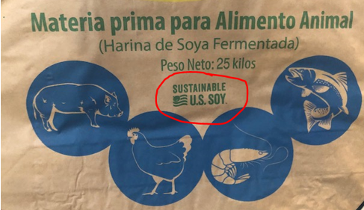
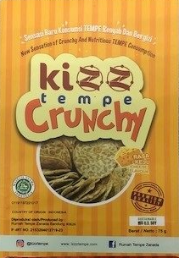
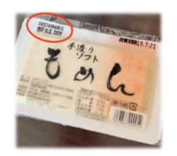
Used in Belize, China, Colombia, Costa Rica, Dominican Republic, Ecuador, El Salvador, Guatemala, Japan, Mexico, Panama, Philippines, Taiwan, Vietnam
Notes:
Some companies are looking for the ability to further differentiate their products and highlight the sustainability of the soy they are purchasing.
A U.S. trademarked logo offers companies that use sustainable U.S. Soy in their products, verified through the SSAP, the opportunity to include the Sustainable US Soy logo on their packaging. The logo is currently being used by more than 35 companies on over 850 products in many countries around the world.
In order to use the Sustainable U.S. Soy logo, companies must source 60% of the soy annually using with an SSAP verification, a licensing agreement must be signed, artwork of the logo must be approved, and detailed recording keeping of SSAP certificates and volumes must be maintained by the company using the logo.

Slide 5
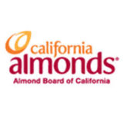

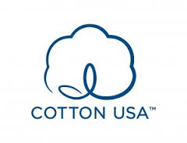
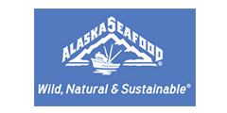
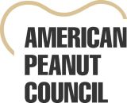

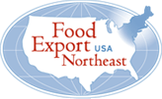









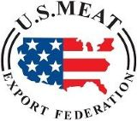




Notes:
U.S. Sustainability Alliance
Mission: Sharing the conservation and sustainability standards, regulations and practices of American farmers, fishermen, and foresters
Vision: Meeting the needs of a growing world through use of sustainable practices, technology, and innovation in agriculture, forestry, and fishery
21 Cooperators currently involved

Slide 6
JimSutter
@1JSutter

