Slide 1


Restaurant Industry 2022
Hudson Riehle
Senior Vice President • Research & Knowledge Group
USDA Agricultural Outlook Forum
February 24, 2022
Washington, DC

Slide 2
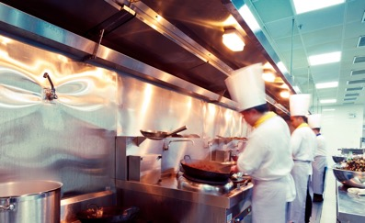
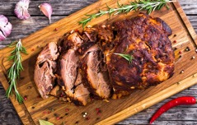
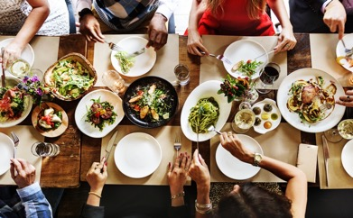

DEFINITION: Restaurant Industry
All meals/snacks/alcohol prepared away
from home,
including all takeout meals and beverages.

Slide 3

RESTAURANT INDUSTRY SALES
2020 FORECAST
$899
BILLION
2020 ACTUAL
$659
BILLION

Slide 4
ECONOMY
National Economy Still Down 3.6 Million Jobs
Total U.S. nonfarm employment – change from previous month
Source: Bureau of Labor Statistics; figures are seasonally adjusted

Slide 5
ECONOMY
Metro Areas Posted Stronger Job Growth in Recent Years
Average annual job growth: metropolitan statistical areas vs. non-metropolitan areas
Source: National Restaurant Association analysis of Bureau of Labor Statistics data, 2013 to 2019

Slide 6
Where Consumers Spent: 2020
CATEGORY | PERCENT OF TOTAL
Housing | 34%
Transportation | 16
Food | 12
Insurance/pensions | 12
Healthcare | 8
Entertainment | 5
Contributions | 3
Clothing | 3
Other | 7
Total | 100%
Source: Bureau of Labor Statistics, Consumer Expenditure Survey – 7/19 thru 6/20 , National Restaurant Association

Slide 7
TRAVEL AND TOURISM
International Tourism Remains Significantly Dampened
International Arrivals to the United States (in millions)
Sources: U.S. Department of Commerce, National Travel and Tourism Office; U.S. Travel Association projections *projected

Slide 8
Percent of adults who used restaurants for these on-premises meal occasions during the previous week
ON-PREMISES
Source: National Restaurant Association, weekly surveys of 1,000 adults conducted by Engine

Slide 9
Percent of adults who used restaurants for these off-premises meal occasions during the previous week
OFF-PREMISES
Source: National Restaurant Association, weekly surveys of 1,000 adults conducted by Engine

Slide 10
Pent-up Demand for On-Premises Dining
Percent of adults who say they are not using restaurants as often as they would like
RESTAURANT SALES
Source: National Restaurant Association

Slide 11
RESTAURANT TRAFFIC
 | Feb 2020* | Nov 2021* | Percentage Point Change
On-Premises | 39% | 19% | -20
Off-Premises | 61% | 81% | +20
Carry-Out | 32% | 30% | -2
Drive-Thru | 26% | 42% | +16
Delivery | 3% | 9% | +6
* Year Ending; May not sum to total due to rounding
Source: NPD Group/CREST; National Restaurant Association

Slide 12
Digital Ordering Increasing
 |  | Feb 2020* | Nov 2021* | Percentage Point Change
Foodservice | Digital | 5% | 12% | +7
 | Non-Digital | 95% | 88% | -7
Quickservice | Digital | 7% | 15% | +8
 | Non-Digital | 93% | 85% | -8
Fullservice | Digital | 3% | 13% | +10
 | Non-Digital | 97% | 87% | -10
* Year Ending; May not sum to total due to rounding
Source: NPD Group/CREST; National Restaurant Association

Slide 13
RESTAURANT SALES TREND
Restaurant Sales Leveled Off in Recent Months
Seasonally-adjusted Monthly Sales at Eating and Drinking Places (in billions)
Source: U.S. Census Bureau

Slide 14
OPERATOR OUTLOOK
Restaurant Operators Said Recruiting Employees Was the Top Challenge Facing Their Business in December
Top challenges facing restaurant operators
December 2019
Recruiting Employees 44%
Food Costs 10
Sales Volume 8
Competition 8
Labor Costs 6
December 2020
Coronavirus 69%
Recruiting Employees 12
Sales Volume 7
Government 4
Food Costs 3
December 2021
Recruiting Employees 61%
Food Costs 20
Coronavirus 6
Government 4
Sales Volume 2
Source: National Restaurant Association, Restaurant Industry Tracking Survey

Slide 15
RESTAURANT JOBS
Restaurant Employment Growth Slowed in Recent Months
Eating and drinking place employment – change from previous month
Source: Bureau of Labor Statistics; figures are seasonally adjusted

Slide 16
OPERATING COSTS
Growth in Restaurant Labor Costs is Accelerating
Annual Growth in Average Hourly Earnings of Eating and Drinking Place Employees
Source: Bureau of Labor Statistics *Year-to-date change through November

Slide 17
RESTAURANT JOBS
November 2021 Restaurant Employment Compared to November 2019 Level
Restaurant operators’ reporting of their current number of menu offerings compared to pre-COVID
Sources: Bureau of Labor Statistics, National Restaurant Association; figures are not seasonally-adjusted

Slide 18
FOOD AND MENU PRICES
Growth in Menu Prices Accelerating
Annual Growth in Consumer Price Index – Food Away From Home vs. Food At Home
Source: Bureau of Labor Statistics

Slide 19
FOOD AND MENU PRICES
Average Wholesale Food Prices Trending Higher
Annual Growth in Producer Price Index – All Foods
Source: Bureau of Labor Statistics

Slide 20
PROFITABILITY
Profit Margins Are Down for Most Restaurants
Restaurant operators’ reporting of profit margins compared to pre-pandemic levels
Source: National Restaurant Association, national survey of 3,000 restaurant operators fielded November 2021

Slide 21
Fullservice Operators Were the Most Likely to Streamline Menus
Restaurant operators’ reporting of their current number of menu offerings compared to pre-COVID
MENU STREAMLINING
Source: National Restaurant Association, 2021

Slide 22
FOOD SUPPLY CHALLENGES
Food Supply Challenges Led to Changes in Menu Offerings
% of restaurant operators* who say their restaurant changed its menu offerings as a result of supply delays or shortages during the previous 3 months
Source: National Restaurant Association, national survey of 3,000 restaurant operators fielded November 2021
*Base: Restaurants that experienced supply delays or shortages of key food or beverage items during the previous 3 months

Slide 23
Assessing Restaurant Technology
TECHNOLOGY
Consumers’ assessment of the amount of technology currently used in restaurants
Source: National Restaurant Association, 2021
Notes:
23

Slide 24
Seeking More Technology
TECHNOLOGY
Areas in which consumers would like to see restaurants incorporate more technology
TECHNOLOGY-FOCUSED AREA | % OF ALL ADULTS
To make ordering and payment easier | 52%
To improve customer service | 51%
To offer more convenient takeout and delivery options | 49%
To make the overall restaurant experience faster | 46%
To provide more detailed information about food, such as nutrition, allergen information, and sourcing | 44%
To provide more entertainment options for customers | 29%
Source: National Restaurant Association, 2021
Notes:
24

Slide 25
Consumer Restaurant Technology Usage
TECHNOLOGY
Consumers who did the following in the past year
ACTIVITY | % OF ALL ADULTS
View a restaurant menu online | 57%
Look up locations, directions, hours of operation | 45%
Place an online order for takeout/delivery | 44%
Read online reviews | 30%
Use mobile pay at a restaurant | 18%
Use a tablet to order at the table | 17%
Use a restaurant kiosk to order | 16%
Make a reservation online | 13%
Source: National Restaurant Association, 2021
Notes:
25

Slide 26
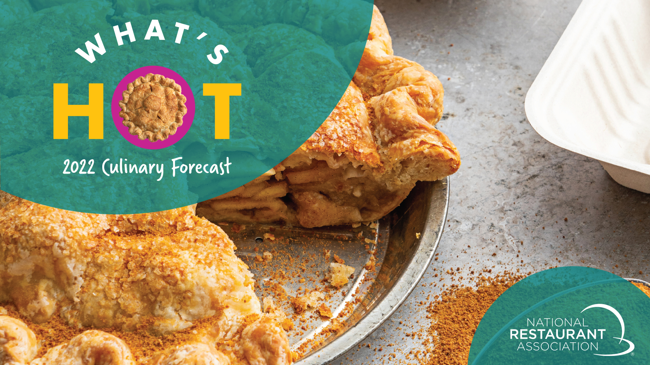

Slide 27
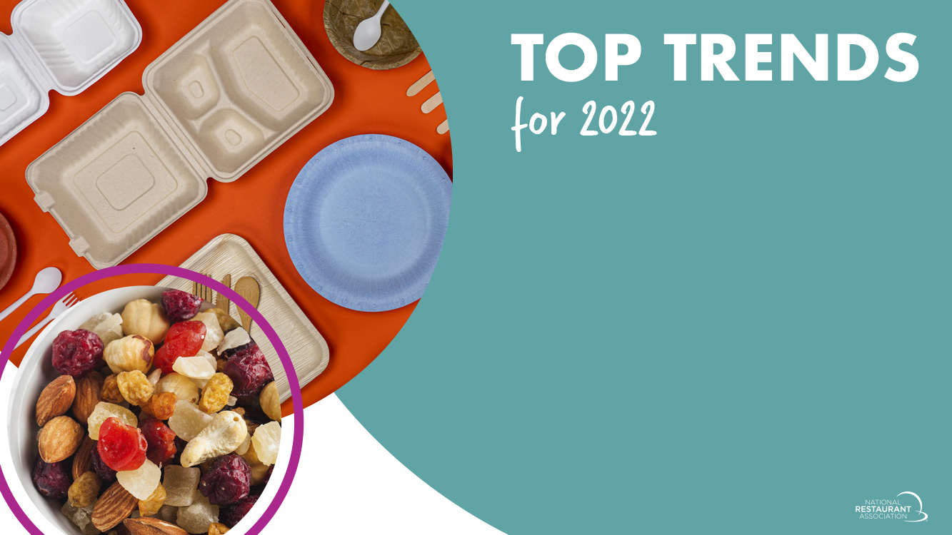
Packaging: Sustainable (reusable/recyclable)
Packaging: Food quality
(travels intact)
Packaging: Retains temperature
Zero waste/sustainability
Immunity-boosting snacks

Slide 28

6. Menu streamlining (fewer menu items,
cutting SKUs)
7. Immunity-boosting/functional ingredients
8. Plant-based sandwiches
9. Packaging: Food security (tamper-proof)
10.Alternative sweeteners (maple sugar,
coconut sugar)

Slide 29

Milk-based cocktails
Mushroom beverages (coffee, etc.)
Breakfast salads
Bone broth/meat stock cocktails
Chicha morada (Peruvian purple corn-based drink)

Slide 30

WRAP-UP

Slide 31
OPERATOR OUTLOOK
The Long Road Back to Normal Business Conditions
Operators’ outlook for when business conditions will return to normal for their restaurant
Source: National Restaurant Association, national survey of 3,000 restaurant operators fielded November 2021

Slide 32

The definition of “restaurant” will change.
2. Off-premises opportunities will drive industry growth.
3. Margin pressures will continue.
4. Data is king.
5. Restaurants will serve — and employ — a different demographic.

Slide 33
WRAP UP
2022 = industry remains
in transition, with: strong geographic variations in performance; sustained food and labor cost pressures.
Converging
macro trends include: pandemic, economics, demographics, food and technology.
Overall economy continues to advance, with consumer pent-up demand for restaurants aiding industry sales growth.
Greater
emphasis
on: delivery, carry-out,
drive-thru, alcohol, ghost/virtual models,
value-added products and
digital.
Consumers still
managing their spend and
need “nudging;” technology
offers distinct competitive advantages
with patrons’ acceptance
growing.
Notes:
–

Slide 34
Restaurant Industry 2022
Hudson Riehle
Senior Vice President • Research & Knowledge Group
USDA Agricultural Outlook Forum
February 24, 2022
Washington, DC

