Slide 1
USDA TARGET Center National Disability Employment Awareness Month Symposium
An Overview of Assistive Technology Products

Slide 2
Advancing Access & Equity

Slide 3
Presenter: Donny Osborn
Email: Donny@BoundlessAt.com
Website: www.BoundlessAt.com

Slide 4
About Us
We are an assistive technology solutions provider located in Portland, OR. We provide a wide range of products designed for those with disabilities. We place a specific emphasis on products for those with visual disabilities.

Slide 5
Learning Objective #1
Understand the range of assistive technology available to support individuals with vision, learning, hearing, mobility, or communication disabilities.

Slide 6
Learning Objective #2
Recognize and name common assistive technology products utilized in various contexts.

Slide 7
Learning Objective #3
Understand the specific use cases and scenarios where assistive technology products may be applicable.

Slide 8
Learning Objective #4
Evaluate the effectiveness and benefits of employing different assistive technology tools

Slide 9
Types of Assistive Technology Products
5 Popular Assistive Technology Categories:
Vision
Learning
Hearing
Mobility
Communication

Slide 10
Vision Products
Hardware Vision Products
Hardware vision products are designed to assist blind and low-vision users. These include magnifiers, braille displays, specialty keyboards, and more.
Software Vision Products
Software vision products make computers, phones, and tablets easier to use for blind and low-vision users. These products include screen readers, magnifiers, unique applications, and more.

Slide 11
Hardware Vision Products - Example
Large Print Keyboards
ZoomText Keyboard
- Yellow/Black
These keyboards use large print
and high-contrast keys to help low-vision users see what they are typing.
ZoomText Keyboard
- White/Black
LogicKeyboard
- Black/White

Slide 12
Hardware Vision Products – Example #1
Braille Displays & Input Devices
Brailliant BI 40X
Braille Display
Braille displays are designed to pair with phones, tablets, laptops, and more.
Users input text via specialized keys. They read text via feeling the adjustable braille dots (or enabling speech output from their device).
Focus 40 Blue 5th Gen
Hable One

Slide 13
Hardware Vision Products – Example #2
OCR Devices
OCR stands for "Optical Character Recognition". OCR devices scan printed text and read it out loud.
Devices like the Pearl Camera (pictured on the left) scan written text. The text is then converted to speech by OCR software like Openbook.
Pearl Camera +
OpenBook OCR Software
Hable One

Slide 14
Hardware Vision Products – Example #3
Electronic Magnifiers
Electronic magnifiers allow users with low vision to increase the size of written and printed text, allowing for easier viewing.
These magnifiers come in all shapes in sizes. They vary from small handheld devices to large desktop devices.
Explore 8
Handheld Magnifier
Reveal 16 Portable
Desktop Magnifier

Slide 15
Hardware Vision Products – Example #4
Electronic Magnifiers - Continued
Pebble HD
Handheld Magnifier
Merlin Ultra
HD CCTV

Slide 16
Video Example: Pebble HD Handheld Magnifier
Video Example:
Pebble HD Handheld Magnifier
Video link: https://www.youtube.com/watch?v=3VZa8aSSV-M

Slide 17
Software Vision Products - Examples
Product:
Use Case:
Magnifier
for low vision users.
Magnifying software makes images and text larger for low-vision computer users.
Screen reading software reads the contents of the screen for blind computer users.
Other software, such as Dolphin Guide, resembles an operating system that has been designed for blind and low vision users. Dolphin has its own native applications, including email, notes, browsing, and more.
ZoomText
JAWS
Screen Reader
for blind users.
Screen Reader and Magnifier
for blind and low vision users.
Fusion
All-In-One Software
for blind and low vision users.
Dolphin
GuideConnect

Slide 18
Video Example Dolphin Guide Connect All-In-One Software
Video Example
Dolphin Guide Connect All-In-One Software
Video link: https://www.youtube.com/watch?v=diWiUKOqNmY

Slide 19
Video Example: ZoomText Magnifier
Video Example:
ZoomText Magnifier
Video link: https://www.youtube.com/watch?v=fhigvPHmHkQ&list=PLk-npwu4WEBQRbTt4YGaGCfDh3IQzUYtJ&index=4

Slide 20
Learning Products
There are thousands of learning products, ranging from hardware to software. For every learning need, there is likely a product designed for it.
Because this category is very broad, this presentation will focus on a handful of effective and popular learning products. These products provide solutions for literacy, dyslexia, and note taking.

Slide 21
Learning Products - Examples
Product:
Use Case:
A smart pen that scans text and reads it out loud.
C-Pen Reader
A software program that reads computer text out loud and provides suggestions for writing.
Read & Write
A smart pen that transcribes written text and audio notes into a digital format.
Livescribe Smart Pen

Slide 22
Video Example: Livescribe Smart Pen
Video Example:
Livescribe Smart Pen
Video link: https://www.youtube.com/watch?v=WDE1G9Srz-s

Slide 23
Hearing Products
When you think about hearing products, you may imagine hearing aids. While hearing aids are perhaps the most popular hearing product, there are many other helpful products
The next slides will highlight 3 popular products that provide solutions for the hard of hearing.

Slide 24
Hearing Products - Examples
Product:
Use Case:
Pockettalker 2.0 Personal Amplifier
The is a personal listening device for the hard of hearing. It uses a microphone to amplify sound to earbuds.
Wake Assure Alarm Clock
This is an alarm clock that uses vibration and flashing lights instead of sound. It is designed for the deaf and hard of hearing.
ClearSounds WCSC600 Amplified Freedom Phone
This is a telephone with amplified volume and large buttons. It is popular with elderly individuals who are hard of hearing.

Slide 25
Video Example: Pocketalker
Video Example:
Pocketalker
Video link: https://www.youtube.com/watch?v=1d5Zn1HyKhw&t=84s

Slide 26
Mobility Products
There are many products that assist individuals with mobility limitations.
The following slides will focus on mobility products for computer users, such as specialized mice, keyguards, software, and more.

Slide 27
Mobility Products - Examples
Product:
Use Case:
The Xbox adaptive gaming controller enables individuals with mobility disabilities to play their favorite games. It is an interface that can be paired with adaptive equipment like switches, joysticks, rollerballs, and more.
Xbox Adaptive Gaming Controller
The smile mouse is software that tracks head movement to control a computer cursor. To click or select items, the user only needs to smile.
Smyle Mouse
Logitech Slimblade Rollerball
The Logitech Slimblade is a computer mouse with a large, accessible roller ball. This product is great for users with limited manual dexterity.

Slide 28
Mobility Products – Examples #2
Dragon is voice dictation software that allows users to write and make commands by using only their voice.
Dragon
3M Ergonomic Mouse
A verticle grip mouse with an ergonomic layout. This is a good solution for those with carpal tunnel syndrome or limited manual dexterity.
Custom keyguards facilitate precise use of keyboards for those with dexterity and motor control limitations.
Custom Keyguard

Slide 29
Video Example: Dragon Dictation Software
Video Example:
Dragon Dictation Software
Video link: https://www.youtube.com/watch?v=xcBeN_IkJWk&t=57s

Slide 30
Communication Products
These products provide users with alternative styles of communication.
They use pictures, pre-recorded voice messages, and customizable layouts to allow nonverbal users to communicate freely.

Slide 31
Communication Products - Examples
Product:
Use Case:
GoTalk Communicator
The GoTalk communicator stores pre-recorded messages that can be triggered by pressing a corresponding button. It is highly customizable and easy to use.
The Big Step-By-Step allows users to play pre-recorded messages with a simple press of a button. Great for nonverbal communicators, or as a language therapy tool.
BIG Step-By-Step
Proloqu2Go is a speech-generating app for phones and tablets. It is flexible and allows users to communicate complex phrases and sentences with a few simple gestures.
Proloquo2Go

Slide 32
Summary
Summary
Categories of assistive technology discussed:
Vision
Learning
Hearing
Mobility
Communication

Slide 33
Thank You!

Slide 34
Questions & Answers

Slide 35
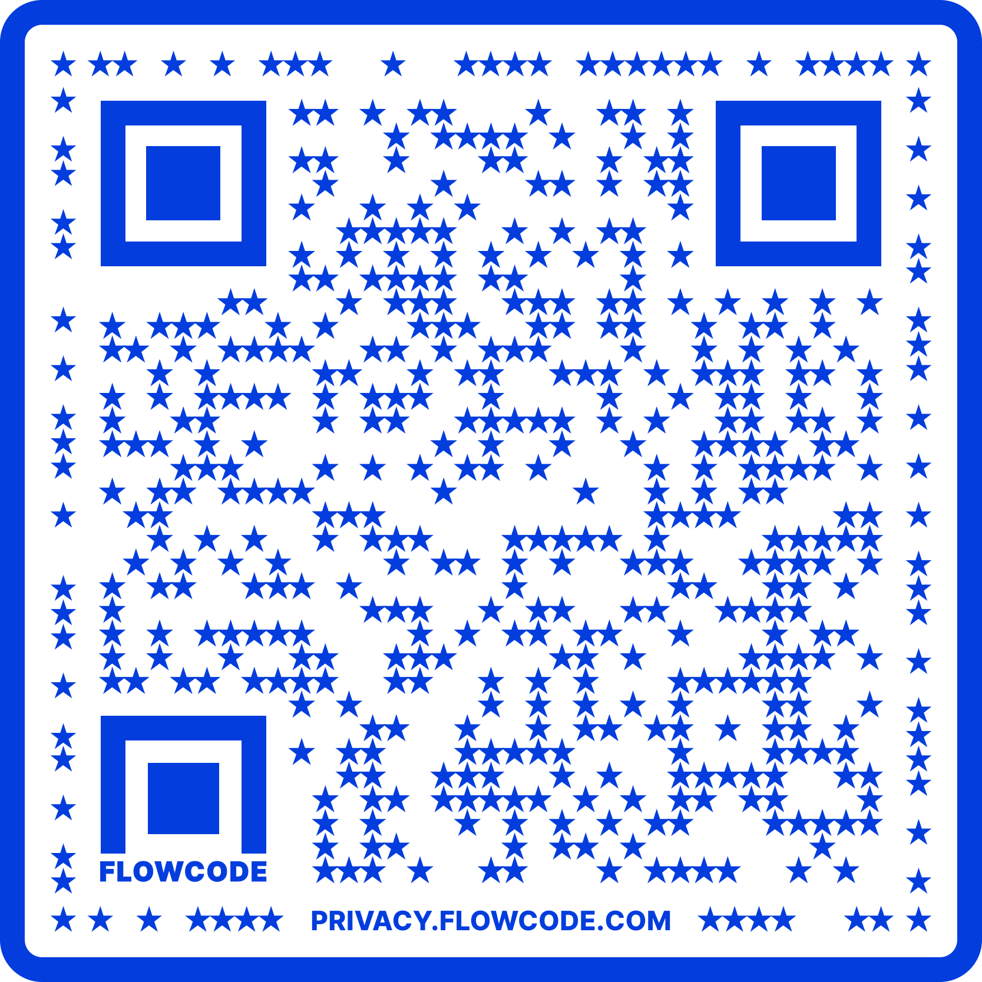
Contact Information
TARGET Center Website https://www.usda.gov/target-center
TARGET Center Email target-center@usda.gov
TARGET Center Phone Number (202) 720-2600

Slide 36
Current and Upcoming Meetings
OCTOBER
MONDAY WEDNESDAY
THURSDAY
TUESDAY
10/2/2023
10/3/223
11:00 AM – 12:00 PM Rethinking Disability and What It Means to Be Disabled
Dr. Theresa Haskins Haskins Consulting
1:00 PM – 2:00 PM
(Neuro) Diversity Includes You
Dr. Theresa Haskins Haskins Consulting
10/4/2023
11:00 AM – 12:00 PM
Nurturing Workplace Well-Being and Supporting Mental Health (Part 1 of 2)
Dr. Theresa Haskins Haskins Consulting
1:00 PM – 2:00 PM
PTSD Is More Common Than You Think
Alla Weinberg Spoke & Wheel
10/5/2023
10:00 AM – 11:00 AM
Empowering Lives Through Assistive Technology Solutions
Donny Osborn Boundless AT
12:00 PM – 1:00 PM
Department of Defense Computer/Electronic Accommodations Program (CAP) Erin Sanderson CAP
10/3/2023
10:00 AM – 11:00 AM
USDA TARGET Center Assistive Technology Program
Rashida Owens Assistive Technology Program Manager
12:00 PM – 1:00 PM USDA TARGET Center Ergonomics Program Stephanie Bradley Ergonomics Program Manager
HOLIDAY
10/10/2023
11:00 AM – 12:00 PM
Autism Inclusion and the Pathway to Neurodiversity Dr. Theresa Haskins Haskins Consulting
1:00 PM – 2:00 PM
Lessons from Unpredictable Journeys: Insights from Temporary and Situational Disabilities (Part 1 of 2)
Dr. Theresa Haskins Haskins Consulting
10/11/2023
11:00 AM – 12:00 PM
Creating a Trauma-Informed Workplace Alla Weinberg Spoke & Wheel
1:00 PM – 2:00 PM Nurturing Workplace Well-Being and Supporting Mental Health (Part 2 of 2)
Dr. Theresa Haskins Haskins Consulting
10/12/2023
10:00 AM - 12:00 PM USDA TARGET Center Ergonomics Demonstrations (Virtual/Onsite) Stephanie Bradley Ergonomics Program Manager Howard Flowers BodyBilt Stephen DiCarlo Humanscale
1:00 PM - 3:00 PM USDA TARGET Center Assistive Technology Demonstrations (Virtual/Onsite)
Rashida Owens Assistive Technology Program Manager

