Slide 1

Digital Accessibility Fundamentals for Websites, Documents, and Videos
www.viscardicenter.org
Notes:
Hello, everyone. My name is Mike Caprara, and it's my pleasure to welcome you to today’s presentation, “Digital Accessibility Fundamentals for Websites, Documents, and Videos”.
(next slide please)

Slide 2
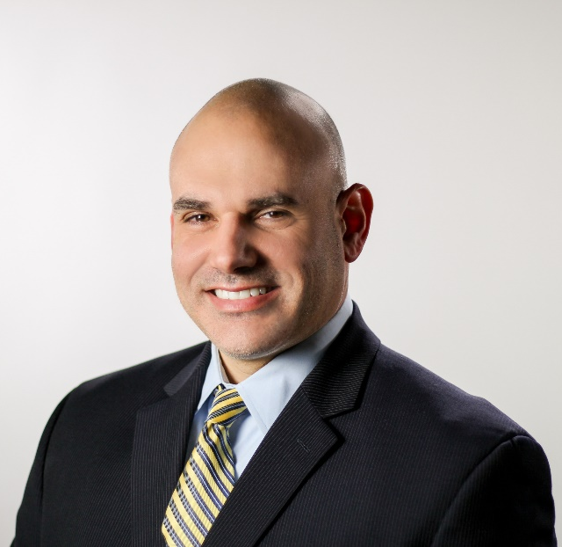
Today’s Speakers
Mike Caprara
Chief Information Officer
The Viscardi Center
Notes:
I have the pleasure of serving as the Chief information Officer for The Viscardi Center, and we’re so pleased that you could join us today to discuss this important topic.
I am joined today by my colleague Jim Corporal. Jim is the Coordinator of Digital Accessibility Services here at The Viscardi Center and is responsible for overseeing and growing the Digital Accessibility Service offering, which ensures that electronic documents, websites, and multi-media files are fully accessible to people with visual and physical disabilities using assistive technologies and screen-reading software.
(next slide please)

Slide 3
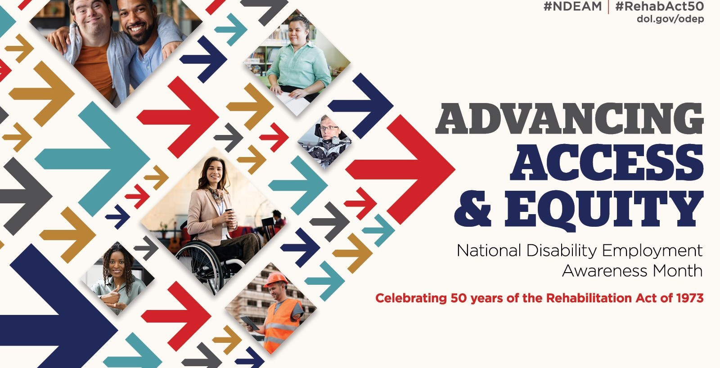
Advancing Access & Equity

Slide 4
What is Digital Accessibility?
Notes:
Digital accessibility refers to the inclusive practice of removing barriers that prevent interaction with, or access to websites, digital tools and technologies, by people with disabilities.
Leveling the playing for students
Empowering people with disabilities by creating independence and retain fulfilling employment and performing at a high level.
Providing a culture of inclusion at your organization.
Provides ACCESS!! Access to your organization’s/businesses “Digital Front Door”.

Slide 5
Digital Accessibility
Website Accessibility
Document Accessibility
Accessibility in Video and Audio Content
Notes:
All 3 are required in order to be fully inclusive.

Slide 6
Website Accessibility

Slide 7
Web Accessibility (1 of 2)
According to the World Wide Web Consortium (W3C) web accessibility means that websites, tools, and technologies are designed and developed so that people with disabilities can use them. More specifically, people can:
Perceive, understand, navigate, and interact with the Web
Contribute to the Web
Notes:
Discuss employment
Purchase of goods and services
Access to research and information

Slide 8
Web Accessibility (2 of 2)
Web accessibility encompasses all disabilities that affect access to the Web, including:
Auditory
Cognitive
Neurological
Physical
Speech
Visual

Slide 9
What’s the impact?
1 in 5 people are estimated to live with a disability (about 1.5 billion people)—with a combined disposable income of more than $1.2 trillion.
This is the largest minority group in the US which also includes
  Aging and elderly
  Someone that is temporarily injured
The internet is currently built with an abundance of ableism, there is little to no attention paid to accessibility outside of regulated industries or after a lawsuit.

Slide 10
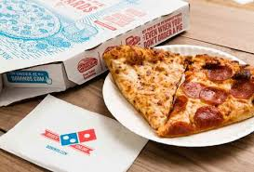
“But I thought this didn’t apply to me!”
“the ADA [Americans with Disabilities Act] applied to Domino’s website and app because the Act mandates that places of public accommodation, like Domino’s, provide auxiliary aids and services to make visual materials available to individuals who are blind.”
Notes:
In 2020, website, application, document (PDF), and video accessibility lawsuits were up almost 25% year-over-year with over 3,500 lawsuits. an average of 10 per day.
• In 2021, Americans with Disabilities Act (ADA) - based lawsuits reached a rate of over 10 per day, with over 4,000 in total; a 15% increase from 2020.
• 74% of the Americans with Disabilities Act (ADA) - based lawsuits on website accessibility were filed against e-commerce sites.

Slide 11
Good News!
There’s a huge upside to accessibility in a large untapped market that can be reached when ability is considered. 1 in 4 adults in America have a disability and they have spending power.
Enhancing the website for most companies is more cost efficient and timely than changing physical attributes of their stores
As we become more educated as a society coding for accessibility will be normal practice
March 2022, the Department of Justice (DoJ) had published guidance on how state and local governments(Title II) & businesses that are open to the public(Title III) can make sure their websites are accessible to people with disabilities inline with ADA’s requirements.

Slide 12
What is WCAG?
Web Content Accessibility Guidelines – Standard on how to develop for web content for accessibility.
Testing
  Automated
  Manual
Remediation/Fixing
Notes:
Discuss different methods. i.e. source code vs overlay
Mobile applications

Slide 13
Document Accessibility
Notes:
At this time, I am going to now ask Jim to discuss Document/PDF Accessibility. Thank you Jim!
[next slide]

Slide 14
Document Accessibility
What is Document Accessibility
How is it Accomplished
Why is it Important?
Notes:
I’m now going to take some time to talk specifically about document accessibility. We’ll start with what document accessibility is, how do we do it, and finally, why it is important.
Next slide, please.

Slide 15
Types of Documents Should be Accessible
  Employee Handbooks
  Job Applications
  New/Legacy Documents
  Training Materials
  Student Worksheets
  Bank Loan Applications
Notes:
So what types of materials should be made accessible?
Well, there are many. They include employee handbooks, job applications, new and legacy documents posted on school district websites, company, government and agency websites, materials and worksheets for students, and mortgage applications to name just a few. As a rule of thumb, any document that might be used by the public, your customers, employees, or other stakeholders should be made accessible.
Next slide, please.

Slide 16
What is Document Accessibility?
Headings are marked
Photos and graphics are tagged (alternative text description)
Forms are generated with fillable fields
Notes:
So what exactly is document accessibility?
Well it’s a software coding or editing process performed by someone who specializes in accessibility authoring techniques. Basically, we ensure that your digital content is accessible by all of your internal and external viewers, including those with low vision and blindness who utilize assistive technology such as screen reading software (one very popular program is called JAWS, spelled: J-A-W-S [and that stands for: Job Access With Speech]). When Adobe PDF files, Microsoft Word documents, and PowerPoint presentations are made accessible through remediation: paragraph headings are marked; the paragraph structures are set; charts, lists, graphs, and tables are modified and adapted; photos, images, and graphics are descriptively tagged; and forms may be generated with fillable fields so that a screen reader can read the content accurately, efficiently, and in the order in which the author intended it to be.
Next slide, please.

Slide 17
How is it Accomplished?
Document Authoring
Automated Checks
Manual Intervention
Quality Assurance
Delivery
Notes:
So How Do We Do It?
Documents are usually created using traditional authoring tools like Microsoft Word or Google Docs. In some cases where no electronic version of a previously created document exists, the document needs to be scanned into a digital file format. These digital files contain something called meta-data or tags. These tags identify the elements we spoke about earlier i.e.: the headings, paragraph structure, charts, lists, and tables, etc. Using proprietary software we assess the file and modify these tags to adhere to compliance rules which gets us about 75-90 percent of the way home.
We then need to review the document for any photos/images/graphics and manually insert descriptive text for each so that the screen reading software knows what to read to a viewer when it comes upon that particular image. Alternative-text is basically a written description of the image, much like a caption. Once we’re happy with the descriptive text entries we then perform a quality check by “listening” to the document using the screen reading software where we confirm all is as it should be, in particular, the reading order is correct, and the figures and images are appropriately described.
The final step to quality assurance is to check the remediated file for compliance. We do this by using the accessibility checker feature built into MS Word, or in the case of an Adobe PDF file, a free tool called the PDF Accessibility Checker (or PAC, for short). If the checkers report any errors we go back and find, correct, and re-test until the file passes. We then deliver the remediated document back to the owner.
Next slide, please.

Slide 18
Why is it Important?
Legal Risk Perspective
Business Case Perspective
Social Inclusion Perspective
Notes:
So why is digital accessibility important?
First, organizations that do not make documents, websites, and videos accessible face exposure to legal risk. Mike touched upon this earlier.
Second, there is an established business case for accessibility, and those organizations that have prioritized addressing it have reaped the benefits.
Lastly, and most importantly, organizations that proactively make their digital content and environments accessible promote social and economic inclusion and are rewarded through increased credibility for their social responsibility efforts.
Next Slide , please.

Slide 19
Legal Risk
Americans with Disabilities Act (ADA)
Sections 508 of the Rehabilitation Act of 1973
WCAG 2.2 (Soon to be WCAG 3.0)
Notes:
Not to harp on the legal aspect as we have already touched upon this but listed here are the 2 guiding legislations affecting digital accessibility, the ADA and Section 508, and WCAG, which is the industry standard that courts are pointing to when adjudicating cases of this
[There are a number of national and international laws that enforce digital accessibility, but the two laws most associated with the flood of recent lawsuits are The Americans with Disabilities Act and Section 508 of the Rehabilitation Act.]
When drafted, Section 508 of the Rehabilitation Act of 1973 mandated that "all electronic and information technology used by the federal government be accessible to people with disabilities." Section 508 was intended to cover federal agencies, but is has been widely accepted that colleges and universities as well are subject to its requirements under Title II because they receive federal funding. The US Access Board recently released an update to 508, which went into effect on January 18, 2018.
The American with Disabilities Act, or ADA is the law most widely associated with digital accessibility for private sector companies. Title III of the ADA, which guarantees nondiscrimination for people with disabilities in “public accommodations”, was the basis of over 2,000 digital accessibility lawsuits in 2018, more than ever before. With major historical settlements and decisions piling up against Target, Bank of America, Winn Dixie supermarkets, and most recently, Domino’s Pizza, it is becoming imperative for all organizations to push accessibility.
Next slide, please.

Slide 20
Business Case
In a new report on disability inclusion from Disability:IN and Accenture, companies that lead in disability inclusion report:
  28% higher revenue
  2X higher net income
  30% better performance on profit margin
Notes:
If Legal Risk doesn’t convince organizations to address digital accessibility, then there’s the strong business case.
Over 57 Million Americans have some form of disability, and that number is growing rapidly as Boomers age into retirement and age-related disabilities.
In the marketplace, accessible digital files ensure current and prospective customers have access to all products and services materials. Various surveys have shown the low-vision population is growing, with over 21 million adults with non-correctable vision loss. From a marketing and revenue perspective alone that number is quite formidable. (just think how nice it would be to suddenly have access to 21 million more potential customers than you do today).
Next slide, please.

Slide 21
Social Inclusion
Making digital environments accessible allows:
  Students of all ages to use eLearning applications and complete schoolwork independently
  Employees to operate internal documents and applications to conduct work and increase productivity
  Customers to navigate websites and apps to shop and use services
  Residents to actively participate in the community
Notes:
Lastly, there is a tangible Social Return on Investment for accessibility, and organizations that promote it are rewarded in kind.
Accessible digital materials in the workplace boost employee productivity for those with and without disclosed disabilities and plays a role in the hiring, retention, and advancement of individuals with disabilities. In a school setting, for instance, it allows children with visual and physical disabilities to fully engage in the classroom and work more independently.
Accessibility supports social inclusion for people with disabilities as well as the aging population, those living in rural areas, and people in developing countries. Accessibility with respect to documents also benefits people without disabilities by providing a more enjoyable end-user experience: documents are much easier to navigate, they are more descriptive, and they keep the viewer engaged.
Alright, that will wrap up our portion on document accessibility.

Slide 22
Accessibility in Video and Audio Content

Slide 23
Accessibility in Video and Audio Content​
Communication Access Realtime Translation - (CART)
Post-production Captioning
Audio Description
Notes:
Outline of topics to be discussed
CART , Post-production Captioning & Audio Description
Who you uses the services
How they are provided.
When and where they can be used.
Why they should be offered from a legal, ethical and business perspective.

Slide 24
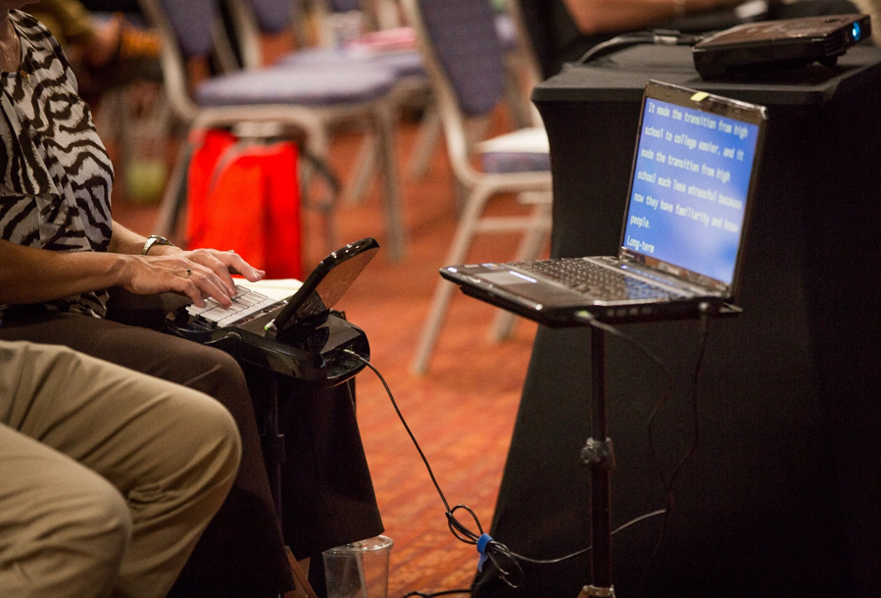
Communication Access Realtime Translation - (CART)
Over 98% accurate
Live Human Captions
On-premise, Remote
Notes:
Define CART, (Communication Access Realtime Translation)
Onsite vs Remote
Explain how it is being used in today's presentation.
Captioners can type over 200 words per minute and are over 98% accurate.
Explain other scenario’s where CART is used.
Students in the classroom & businesspeople in meetings.
Conferences
Events streaming on-line both on your website or Facebook & YouTube
21st Century Communications and Video ACT (CVAA)

Slide 25

Post-production Captioning
Embedded Video
YouTube/Vimeo
Learning Management Systems (LMS)
APIs
Notes:
Why does your video need to be captioned.
ADA
Title II
Title III
FCC
Section 504 & 508
21st Century Communications and Video Accessibility Act (CVAA)
Who uses captioning.
The World Health Organization did a study and determined that 20% of American’s are d/Deaf or have hearing loss.
Many more who do not have hearing loss use captions.
Social media video’s default to no sound.
The case for open captions,
Not all captions are created equally.
Automatic speech recognition
Our process for captioning a video.
Human Transcription
Human Alignment
Human Quality Control

Slide 26

Audio Description
Extended vs. Standard
Netflix & Disney+ have over 1,000 titles available.
Notes:
Define AD and terms related to AD
Extended AD
Why should your video have AD
W.H.O states that 10% of Americans have vision loss
FCC mandates stations provide 50 hours of AD programming per year.
Who uses AD
Netflix and Disney+ provide over 1,000 titles with Audio Description.

Slide 27
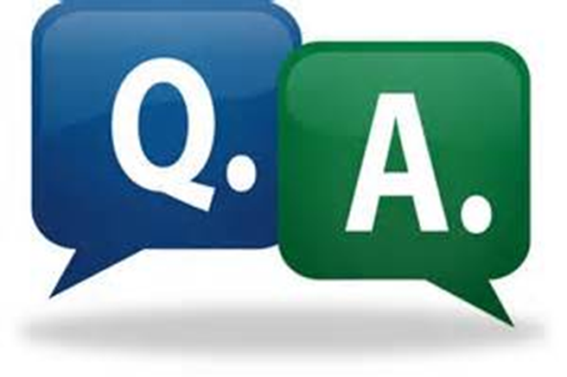
Audience Questions
Notes:
Now, let’s take some audience questions!

Slide 28
Contact Information (1 of 2)
Mike Caprara
Chief Information Officer
The Viscardi Center
Email: mcaprara@viscardicenter.org
Website: https://www.viscardicenter.org
Notes:
If you would like to learn more about Digital Accessibility Services at The Viscardi Center, please contact either myself or Jim Corporal. Our contact information is now listed on the screen, or you could simply go to www.viscardicenter.org/digital-accessibility-services/ and simply fill out the “Digital Accessibility Interest Form”. Someone will reach out to you as soon as possible.
[next slide please]

Slide 29

Contact Information (2 of 2)
201 I.U. Willets Road, Albertson, New York 11507
www.viscardicenter.org | 516.465.1400

Slide 30
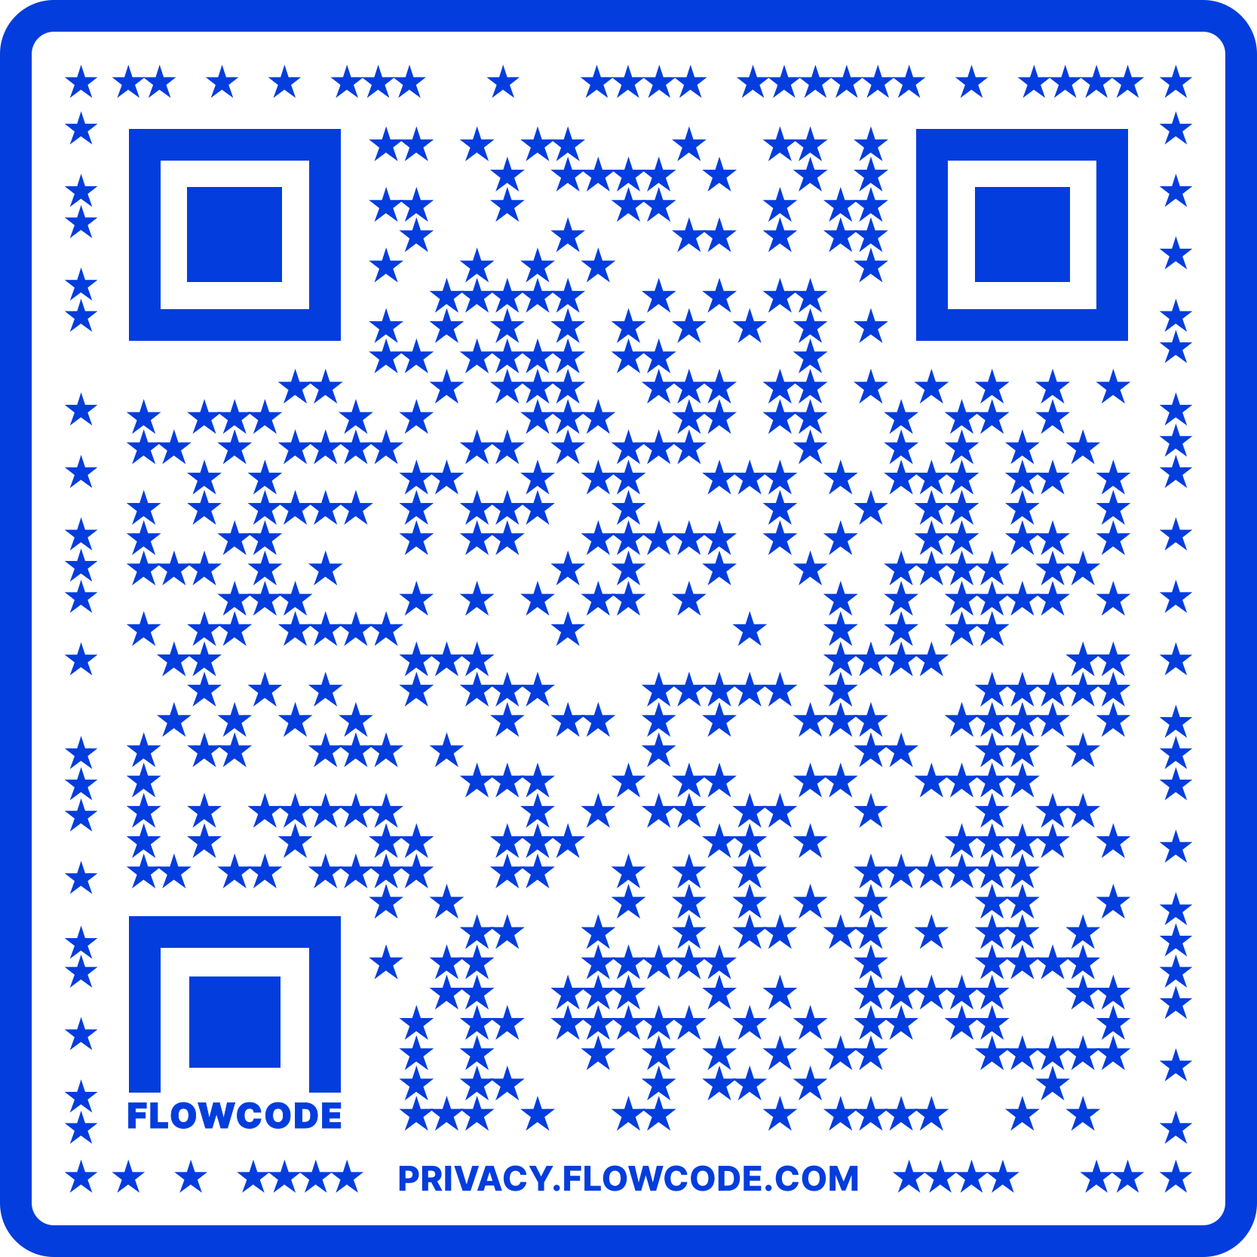
Contact Information
TARGET Center Website
https://www.usda.gov/target-center
TARGET Center Email
target-center@usda.gov
TARGET Center Phone Number
(202) 720-2600

Slide 31

Current and Upcoming Meetings, cont.
OCTOBER
MONDAY WEDNESDAY
THURSDAY
TUESDAY
10/16/2023
11:00 AM – 12:00 PM
USDA TARGET Center
Accessible Communications
Program
Nancy Frohman
Accessible
Communications
Program Manager
1:00 PM – 2:00 PM
USDA TARGET Center
Education Program
Michelle Sherbondy
Education Program Manager
10/17/2023
11:00 AM – 12:00 PM
Unmasking Hidden Challenges: Chronic Conditions in the Workplace
Dr. Theresa Haskins Haskins Consulting
1:00 PM – 2:00 PM
Equity, Accessibility, and Inclusion in the Workplace (Part 1 of 2)
Dr. Theresa Haskins Haskins Consulting
10/18/2023
10:00 AM – 11:00 AM
Ergonomic Equity: Addressing Risk Factors Through Job Analysis and Prevention
Sandra Miller
Britroix
12:00 PM – 1:00 PM
Digital Accessibility Fundamentals for Websites, Documents, and Video
Mike Caprara
The Viscardi Center
10/23/2023
11:00 AM – 12:00 PM
Emotional Intelligence (Part 1 of 2)
Carolyn Owens,
MCC, SPHR
1:00 PM – 2:00 PM
Proper Posture in the Workplace to Prevent Posture-Related Problems (Part 1 of 2)
Dr. Krista Burns
American Posture Institute
10/24/2023
11:00 AM – 12:00 PM
Thriving with ADHD at Work
Dr. Theresa Haskins Haskins Consulting
1:00 PM – 2:00 PM
Equity, Accessibility, and Inclusion in the Workplace (Part 2 of 2)
Dr. Theresa Haskins Haskins Consulting
10/25/2023
10/26/2023
10:00 AM – 11:00 AM
Assistive Technology at New Heights
Dr. Wayne Crolley
Novare Products, LLC
10/25/2023
10:00 AM - 12:00 PM
USDA TARGET Center
Accessible Communications Demonstrations
(Virtual/Onsite)
Nancy Frohman
Accessible Communications
Program Manager
1:00 PM - 3:00 PM
USDA TARGET Center
Education Demonstrations
(Virtual/Onsite)
Michelle Sherbondy
Education Program Manager

